Slide 1
Internet of Things
Module 6, Lesson 4:
Introduction to IoT Hub

Slide 2
Topics
Introduction to IoT Hub in Azure

Slide 3
Objectives
By the end of this lesson you should be able to:
Understand IoT solution and Azure IoT Suite.
Understand IoT Hub in Azure

Slide 4
Connecting Devices to the Cloud
Challenges:
Communication protocols
Platform specificities
Security
Device identification
Command and control
IP capable device or not.
Notes:
Notes:
One of the challenges to developing an IoT solution is getting devices connected to the cloud.
We can solve these problems with Azure IoT Suite and Azrue IoT Hub.

Slide 5
What is Azure IoT Suite?
Preconfigured solutions with a broad range of capabilities for IoT
Collect data from devices
Analyze data streams in-motion
Store and query large data sets
Visualize both real-time and historical data
Integrate with back-office systems
Notes:
Notes:
The Azure IoT Suite is an enterprise-grade solution that enables you to get started quickly through a set of extensible preconfigured solutions that address common IoT scenarios, such as remote monitoring and predictive maintenance.
Preconfigured Azure services - IoT Hub, Event hubs, Stream Analytics, Machine Learning, Azure storage, so on.

Slide 6
Solutions Map to Specific IoT Features
Solution | Data Ingestion | Device Identity | Command and Control | Rules and Actions | Predictive Analytics
Remote monitoring | Yes | Yes | Yes | Yes | -
Predictive maintenance | Yes | Yes | Yes | Yes | Yes
Notes:
Notes:
Data ingestion : Ingress of data at scale to the cloud.
Device identity : Manage unique identities of every connected device.
Command and control : Send messages to a device from the cloud to cause the device to take some action.
Rules and actions : The solution back end uses rules to act on specific device-to-cloud data.
Predictive analytics : The solution back end applies analyzes device-to-cloud data to predict when specific actions should take place.

Slide 7



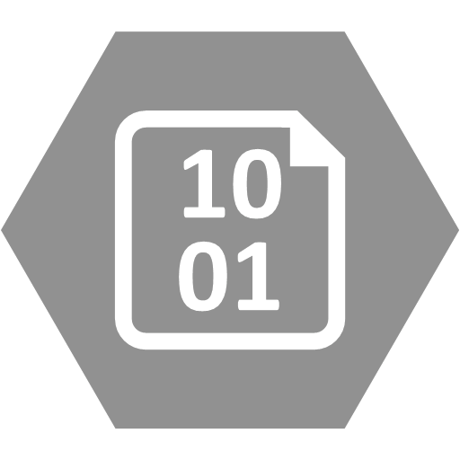

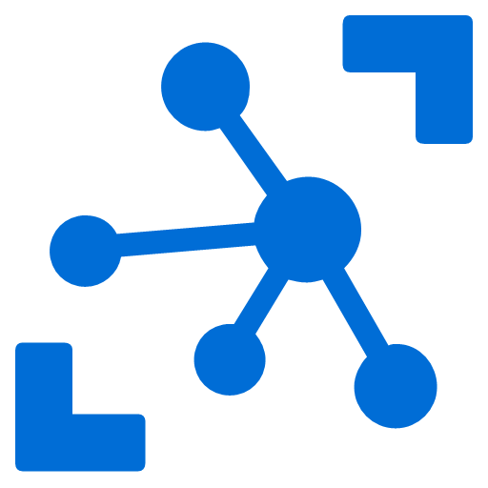




Remote Monitoring Preconfigured Solution Overview
Power BI
Azure
Active Directory
Devices
Web/Mobile App
Back-end
System and
Processes
Storage Blobs
DocumentDB
IoT Hub
Stream Analytics
Event Hub
Web Jobs
Logic Apps
Notes:
Notes:
This diagram illustrates the key elements of the remote monitoring solution for IoT Suite example.

Slide 8
What is IoT Hub?
The gateway for device to connect to the cloud in Azure
Millions of simultaneously connect devices
Per-device authentication
High throughput device to cloud messaging
Multi-protocol and platform
Notes:
Notes:
Core to Azure IoT Suite is the Azure IoT Hub service. This provides the device-to-cloud and cloud-to-device messaging capabilities and acts as the gateway to the cloud and the other key IoT Suite services.

Slide 9
What is IoT Hub? (Cont.)
Data path
Optional solution component
IoT solution component
Local
Cloud
IoT Hub
IoT solution backend
IP-capable devices
IoT device Library
Event-based device-to-cloud ingestion
AMPQS, MQTT, HTTPS
Existing IoT devices
MQTT or custom
Reliable cloud-to-device messaging
IoT device Library
IoT protocol Gateway
IoT device Library
Per-device authentication and secure connectivity
Low-power devices
IoT field Gateway
AMPQS
IoT device Library
AMPQS
Azure IoT Suite
Notes:
Notes:
Azure IoT Hub is a fully managed service that enables reliable and secure bidirectional communications between millions of IoT devices and a solution back end.
Provides reliable device-to-cloud and cloud-to-device messaging at scale.
Enables secure communications using per-device security credentials and access control.
Provides extensive monitoring for device connectivity and device identity management events.
Includes device libraries for the most popular languages and platforms.
References:
TCP
http://tools.ietf.org/html/rfc793
UDP
http://tools.ietf.org/html/rfc768
AMQP
http://www.amqp.org/
AMQP Core
http://docs.oasis-open.org/amqp/core/v1.0/os/amqp-core-overview-v1.0-os.html
MQTT
http://mqtt.org/ http://docs.oasis-open.org/mqtt/mqtt/v3.1.1/mqtt-v3.1.1.html
CoAP
http://en.wikipedia.org/wiki/Constrained_Application_Protocol

Slide 10
What is IoT Hub? (Cont.)
For the device side
For the service side
IoT Hub Management
IoT Hub
Device ID
D2C receive
endpoint
D2C send
endpoint
C2D queue
endpoint
C2D send
endpoint
Device …
IoT Hub
management
Message feedback endpoint
Device …
Device Identity management
Device …
Notes:
Notes:
In the device side, each device gets its own unique endpoints for security purposes and for isolation between devices.
Each device has an endpoint to send D2C messages, and to receive C2D messages. Field GW and Cloud GW can connect to multiple of these endpoints at the same time using the same TCP connection.
Iot Hub management endpoint is used to change security and functional parameters of user own IoT Hub instance.

Slide 11
Service Side in IoT Hub
Back-end receive from the D2C receive endpoint
C2D send endpoints to send message to individual devices
Feedback endpoint provides delivery status information
Device Identity management provides secure connectivity between cloud and device
D2C receive
endpoint
C2D send
endpoint
Message feedback endpoint
Device Identity management
Notes:
Notes:
This device-to-cloud receive endpoints is compatible with EventHubs, so any solution that you have that is currently using EventHubs will be very easily migrated to use IoTHub.

Slide 12
Why Use Azure IoT Hub
Benefits of IoT Hub
Per-device authentication and secure connectivity
Monitoring of device connectivity operation
An extensive set of device libraries
Scale
Notes:
Notes:
User can provision each device with its own security key to enable it to connect to IoT Hub.
The IoT identity registry stores device identities and keys.
User can receive detailed operation logs about device identity management operations and device connectivity events such as wrong credentials, send message too frequently, or reject all cloud to device messages.
Supported for a variety of languages and platforms such as C#, Java, JavaScript, and C for Linux, Windows, and RTOS.
Scales to millions of simultaneously connected devices and millions of events per second.

Slide 13
Why Use Azure IoT Hub (Cont.)
Benefits of IoT Hub
IoT protocols and extensibility
Event-based device-to-cloud ingestion
Reliable cloud-to-device messaging or commands
Notes:
Notes:
User can extend IoT Hub to provide support for custom protocols with Azure IoT Gateway SDK.
Receive millions of events per second from device, and process them by using an event processor engine. It also store them for analysis during some days.
Send messages with an at-least-one delivery guarantee to individual devices. It request both delivery and expiration receipts for full visibility into the life cycle of message.

Slide 14
IoT Hub vs Event Hubs
Area | IoT Hub | Event Hub
Communication patterns | Enables device-to-cloud and cloud-to-device messaging. | Only enables event ingress
Protocol Support | Supports AMQP, AMQP over WebSockets, MQTT, and HTTP/1. | Supports AMQP, AMQP over WebSockets, and HTTP/1
Security | Provides per-device identity and revocable access control | Provides Event Hubs-wide shared access policies, with limited revocation support through publisher's policies.
Device SDKs | Provides device SDKs for a large variety of platforms and languages | .NET, and C. Also provides AMQP and HTTP send interfaces.
Scale | Support millions of simultaneously connected devices. | Up to 5,000 AMQP connections, as per Azure Service Bus quotas.
Notes:
References:
Service Bus quotas - https://azure.microsoft.com/en-us/documentation/articles/service-bus-quotas/
SDKs - https://github.com/Azure/azure-iot-sdks/blob/master/readme.md

Slide 15
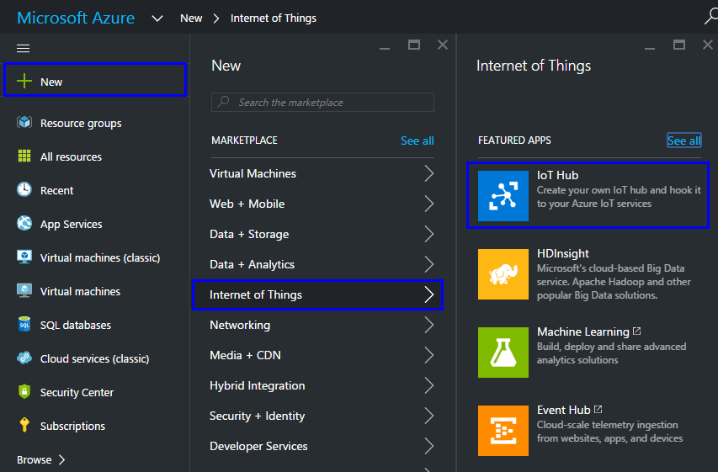
How to Create an IoT Hub in Azure
Create a new IoT Hub for your solution
New > Internet of Things > IoT Hub
Notes:
Notes:
Here, it illustrates an main process and field value for making the new IoT Hub briefly.

Slide 16
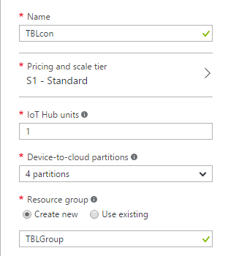
How to Create an IoT Hub in Azure (Cont.)
IoT Hub Units – based on your total message count and the number of connected devices
D2C partitions – the number of partitions for device to cloud messages

Slide 17
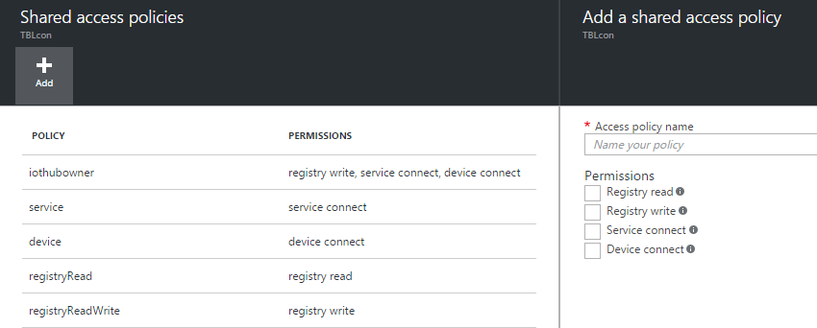
How to Create an IoT Hub in Azure (Cont.)
Notes:
Notes:
In the settings user can see that there are many sections.
This figure is about shared access policies setting. This pertains to security. The user can create different shared access policies, and each access policy has different permissions.

Slide 18
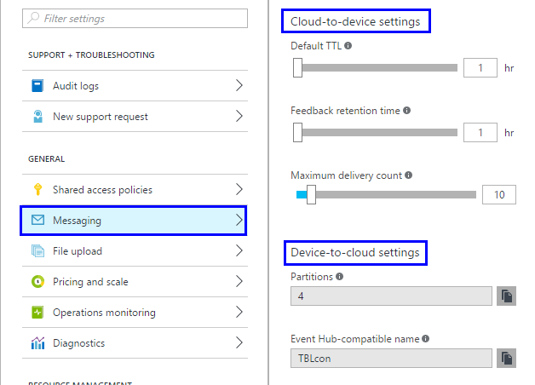
How to Create an IoT Hub in Azure (Cont.)
Messaging section
C2D setting
D2C setting
Notes:
Notes:
There are two section for cloud to device settings and device to cloud settings.
The feedback retention time is how much this feedback is going to be retained in the system.
In this case, it is one hour.

Slide 19
Azure IoT Suite SDKs
Two types of SDKs:
Device-facing - For devices and field gateway
Platforms : RTOS, Linux, Windows, Android, iOS…
Languages : C, Java, C#, Javascript
Service-facing - For back-ends and cloud gateway
Languages : .NET C#, Java, Node

Slide 20
Summary
In this lesson, you have learned:
Understand IoT solution and Azure IoT Suite
Understand IoT Hub in Azure
Notes:
Notes:
The Module 6 Lesson 4 Lab should be completed at this time:
https://github.com/MSFTImagine/computerscience/tree/master/Complimentary%20Course%20Content/Module6/Labs

